Slide 1
ELEVATE YOUR VISION
THE REVOLUTION IS HERE

Slide 2
INTRODUCING THE FUTURE:
PPRESENTING

Slide 3
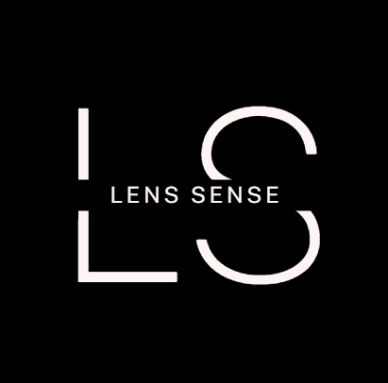

Slide 4
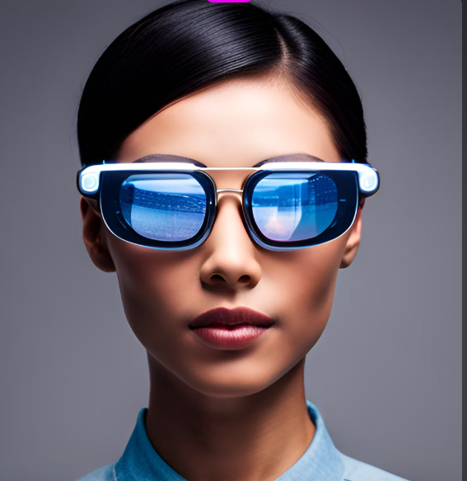
WHAT IS LENS SENSE?
LENS SENSE are a type of wearable technology that allow users to access digital information without the need for a separate device.
By using smart glasses, users can seamlessly integrate technology into their daily lives, allowing them to stay connected and productive while on the go.

Slide 5
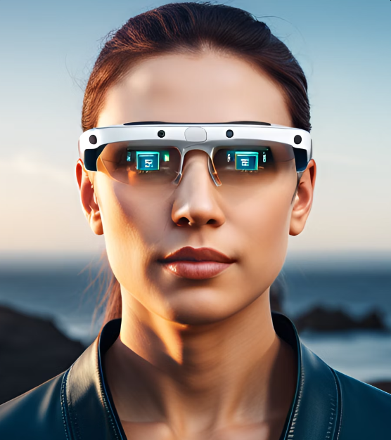
FEATURES
Our smart glasses come equipped with voice commands using which you can stay connected and on top of your schedule.
Augmented reality is integrated into our SMART SENSE. From restaurant reviews to historical facts, our smart glasses can enhance your daily experiences and help you discover new things about the world.

Slide 6

Benefits of LENS SENSE
Smart glasses provide users with hands-free convenience, allowing them to access information and complete tasks without having to hold a device or use their hands.
In addition to hands-free convenience, smart glasses can also improve productivity by providing users with real-time information and reducing the need to switch between devices.
Finally, smart glasses offer enhanced entertainment experiences by providing users with immersive augmented reality content. From gaming to education, smart glasses allow users to interact with digital content in a way that feels natural and engaging.

Slide 7
MARK YOUR CALENDERS
LAUNCHING ON
DECEMBER 2, 2023

Slide 8
ANY QUESTIONS?

Slide 9
THANK YOU

